Slide 1
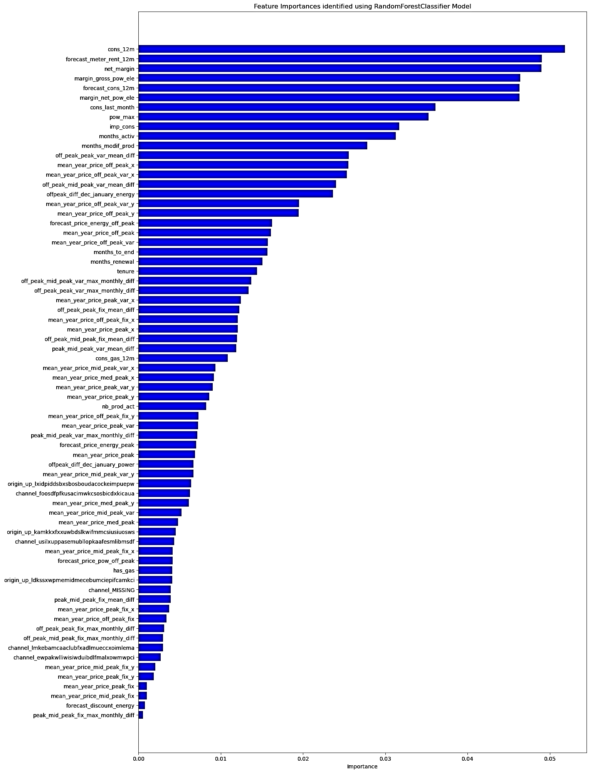
Executive summary for PowerCo
From the model, price is not a major factor of churn.
According to the Model: -
Electricity consumption for past 12 months is the highest determining factor of customer churn.
Then, comes the Forecast Meter Rental for next 12 months
Then, we have Net Margin
Then, we have Margin for Gross Power Electricity. Followed by
Consumer Forecast for next 12 Months.

